Slide 1
DS 303 Project
-Gudla Raghunandan Reddy (190010027)
-Pukh Raj (190110068)
-Satyajeet Shahaji Machale (190110085)

Slide 2
Image Segmentation Techniques

Slide 3
Image segmentation
Human can easily read image but in reality when the question come on the machine that how it read image then it is difficult task for us. We are trying the machine to read image and give useful information to us.
Image Segmentation is the process by which a digital image is partitioned into various subgroups (of pixels) called Image Objects, which can reduce the complexity of the image, and thus analysing the image becomes simpler.
In this presentation we will use various algorithms to segment the image.

Slide 4
Image Segmentation
Thresholding
Clustering
Region-Based Segmentation
Region Growing
Watershed-Based Segmentation
Edge-based Segmentation
PDE Segmentation
Region Splitting
Split and Merge
K-means

Slide 5
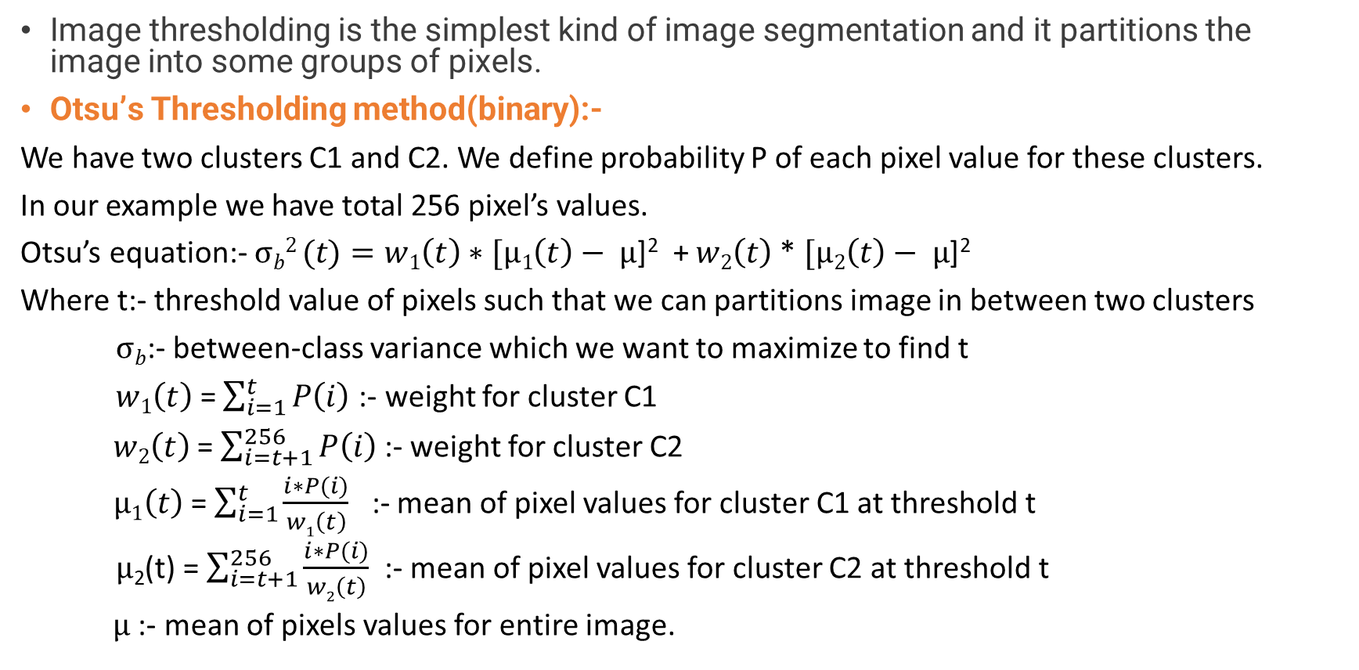
1). Thresholding
Image thresholding is the simplest kind of image segmentation and it partitions the image into some groups of pixels.
Otsu’s Thresholding method(binary):-
We have two clusters C1 and C2. We define probability P of each pixel value for these clusters.
In our example we have total 256 pixel’s values.
Otsu’s equation:- $σb2 (t)=w1\left(t\right)∗[µ1\left(t\right)− µ$]² + $w2\left(t\right)$* $[µ2\left(t\right)− µ$]²
Where t:- threshold value of pixels such that we can partitions image in between two clusters
$σb$:- between-class variance which we want to maximize to find t
$w1\left(t\right)$ = $\sum_{i=1}^{t}{P\left(i\right) }$:- weight for cluster C1
$w2\left(t\right)$ = $\sum_{i=t+1}^{256}{P\left(i\right) }$:- weight for cluster C2
$µ1\left(t\right)$ = $\sum_{i=1}^{t}{\frac{i∗P(i)}{w1\left(t\right)}}$ :- mean of pixel values for cluster C1 at threshold t
$µ$₂(t) = $\sum_{i=t+1}^{256}{\frac{i∗P(i)}{w2\left(t\right)}}$ :- mean of pixel values for cluster C2 at threshold t
$µ$ :- mean of pixels values for entire image.

Slide 6
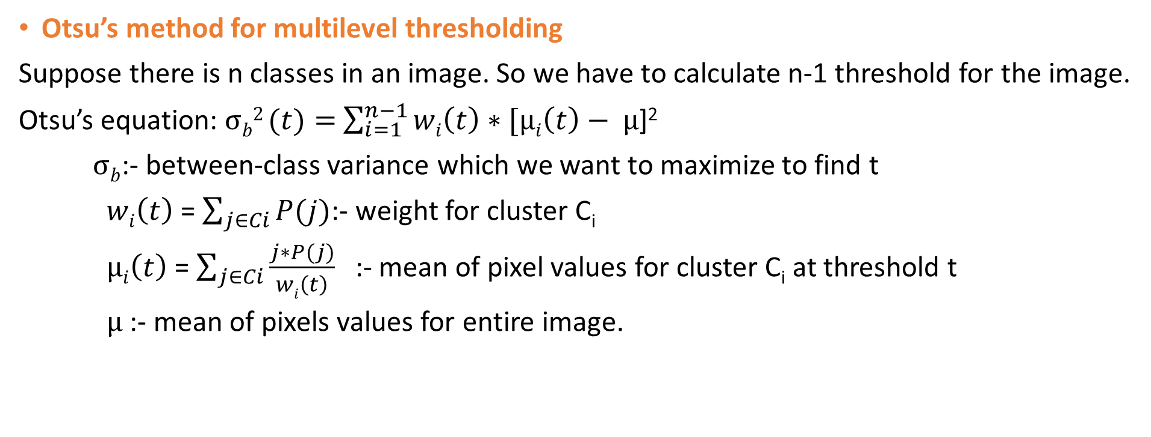
Otsu’s method for multilevel thresholding
Suppose there is n classes in an image. So we have to calculate n-1 threshold for the image.
Otsu’s equation: $σb2 (t)=$ $\sum_{i=1}^{n−1}{wi\left(t\right)∗[µi\left(t\right)− µ\text{]}\text{2}}$
$σb$:- between-class variance which we want to maximize to find t
$wi\left(t\right)$ = $\sum_{j∈Ci}{P(j)}$:- weight for cluster C_{i}
$µi\left(t\right)$ = $\sum_{j∈Ci}{\frac{j∗P(j)}{wi\left(t\right)}}$ :- mean of pixel values for cluster C_{i} at threshold t
$µ$ :- mean of pixels values for entire image.
Steps
1). Input Image
2). Distribution of image pixels (histogram)
3). Finding the threshold values(using Otsu’s methods)
4). Replace the pixels into colourful regions ( Using threshold values)

Slide 7
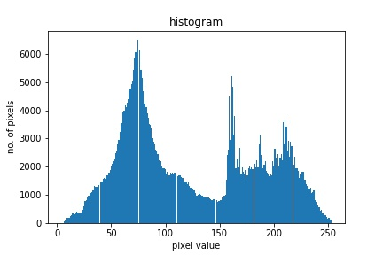
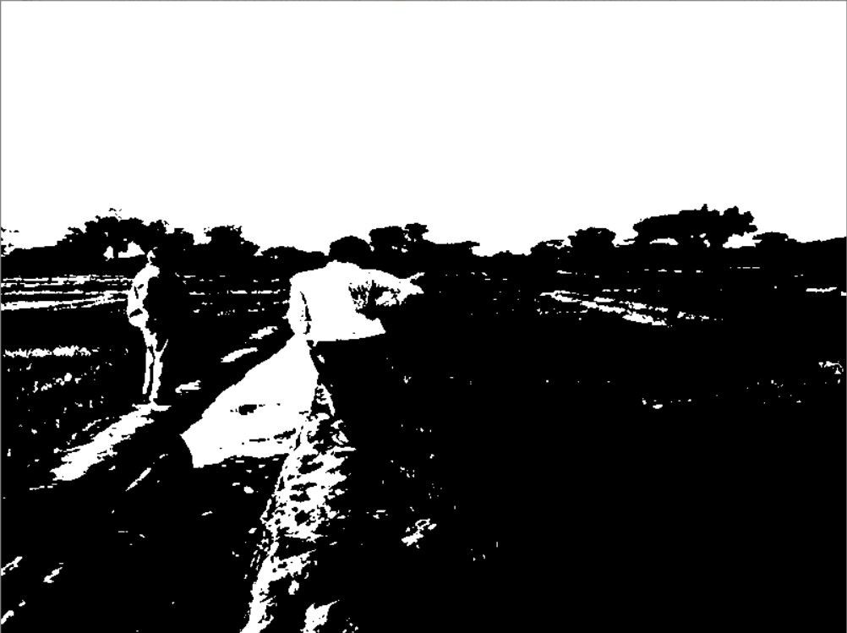
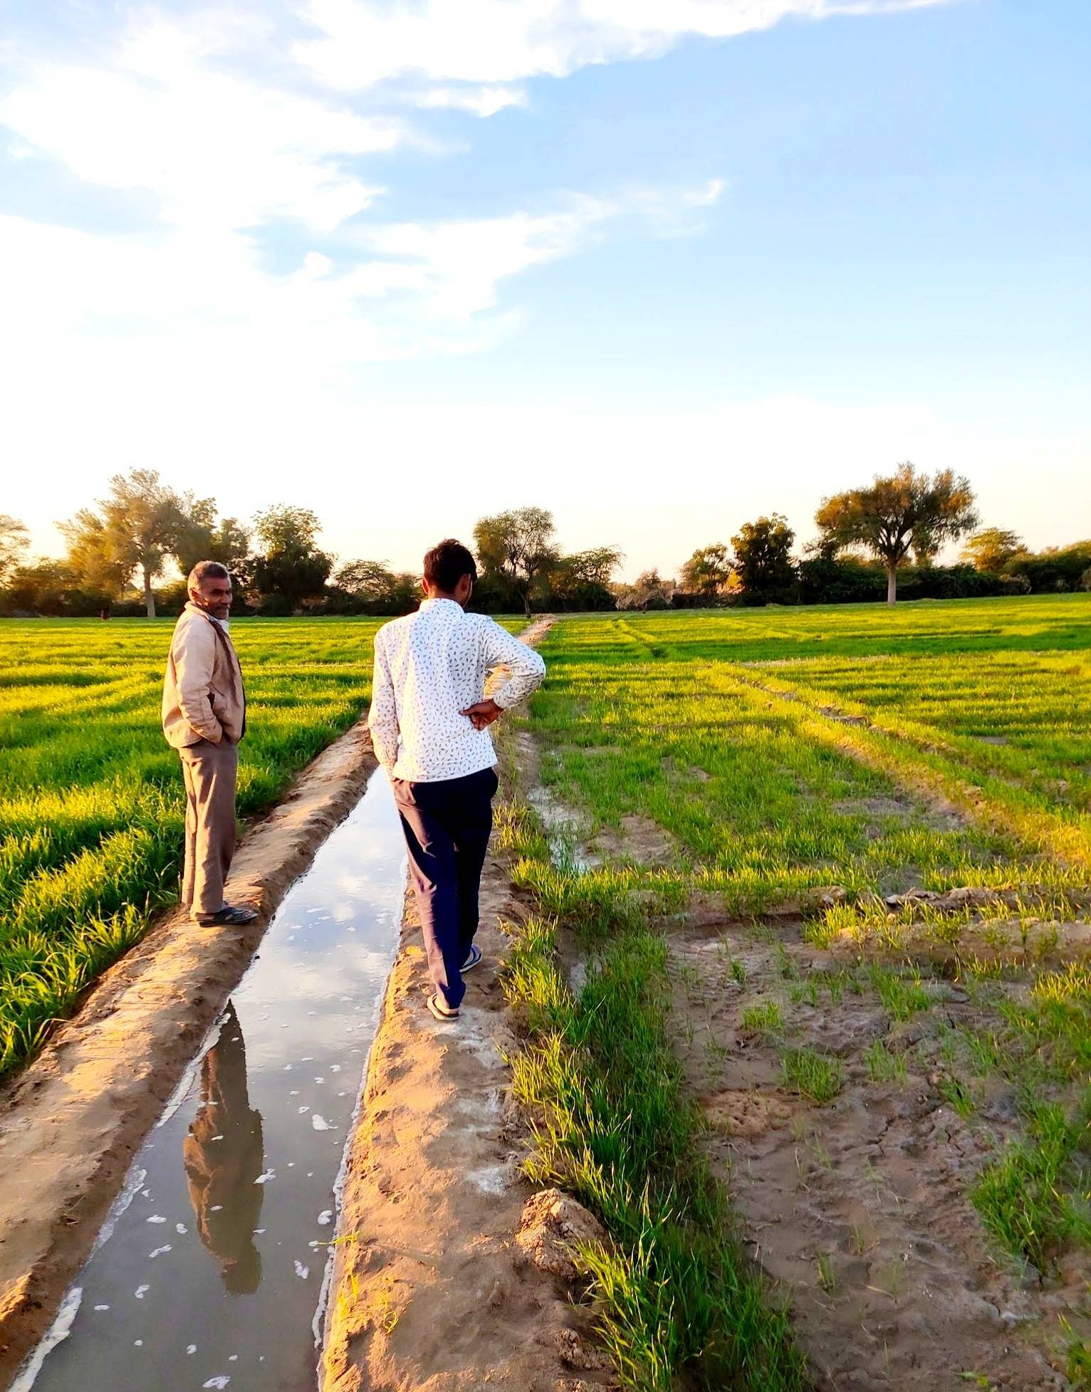
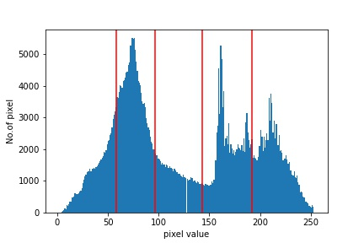
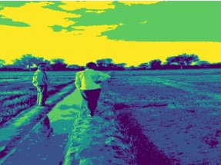
Otsu Binary Thresholding (top two plots)
Otsu Multilevel Thresholding (Bottom two plots)
Thresholds values

Slide 8
2). Edge-based segmentation
1). First order derivative methods:-
i). Roberts operator
ii). Prewitt operator
iii). Sobel operator
2). Second order derivative methods:-
i). Laplacian
3). Canny edge detection

Slide 9
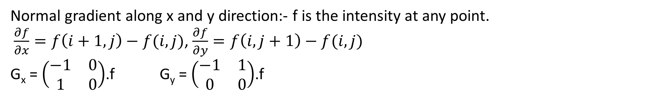
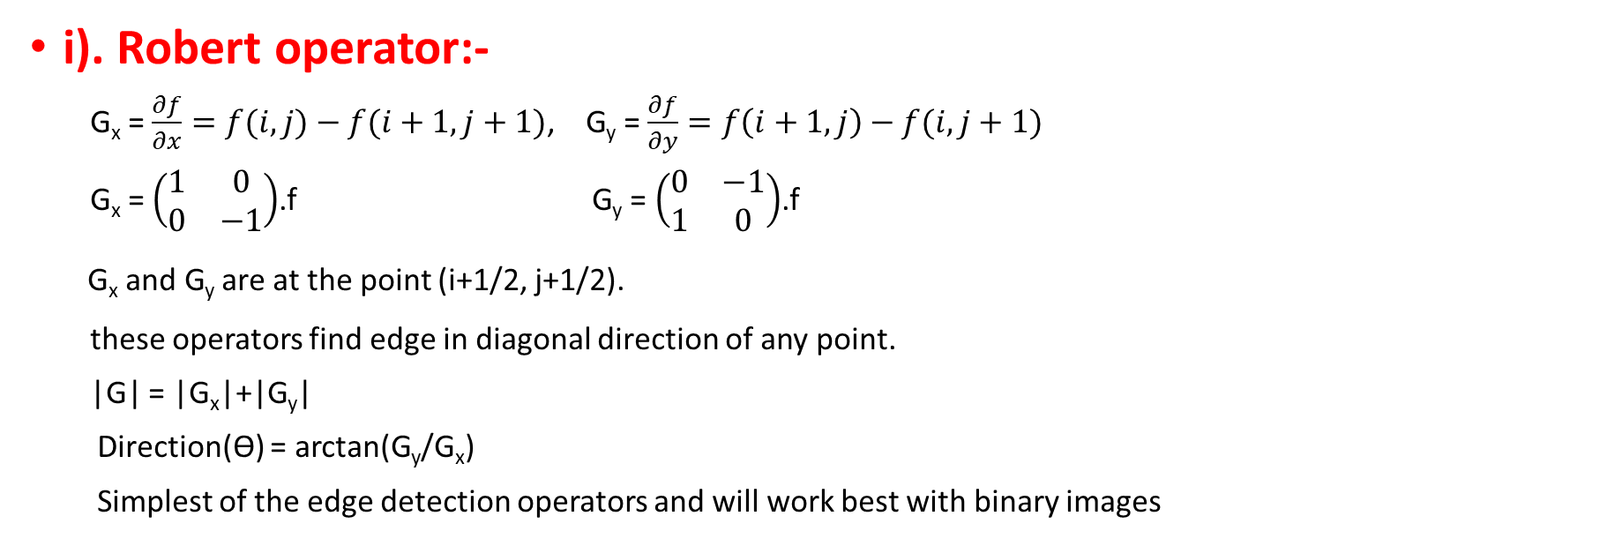
Edge detection 1). First order derivative methods
Normal gradient along x and y direction:- f is the intensity at any point.
$\frac{∂f}{∂x}=f\left(i+1,j\right)−f(i,j)$, $\frac{∂f}{∂y}=f\left(i,j+1\right)−f(i,j)$
G_{x} = $\left(\begin{matrix}−1 & 0 \\ 1 & 0\end{matrix}\right)$.f G_{y} = $\left(\begin{matrix}−1 & 1 \\ 0 & 0\end{matrix}\right)$.f
i). Robert operator:-
G_{x} = $\frac{∂f}{∂x}=f(i,j)−f(i+1,j+1)$, G_{y} = $\frac{∂f}{∂y}=f\left(i+1,j\right)−f(i,j+1)$
G_{x} = $\left(\begin{matrix}1 & 0 \\ 0 & −1\end{matrix}\right)$.f G_{y} = $\left(\begin{matrix}0 & −1 \\ 1 & 0\end{matrix}\right)$.f
G_{x} and G_{y} are at the point (i+1/2, j+1/2).
these operators find edge in diagonal direction of any point.
|G| = |G_{x}|+|G_{y}|
Direction(ϴ) = arctan(G_{y}/G_{x})
Simplest of the edge detection operators and will work best with binary images
f(i,j) | f(i,j+1)
f(i+1,j) | f(i+1,j+1)
(i+1/2,j+1/2)

Slide 10
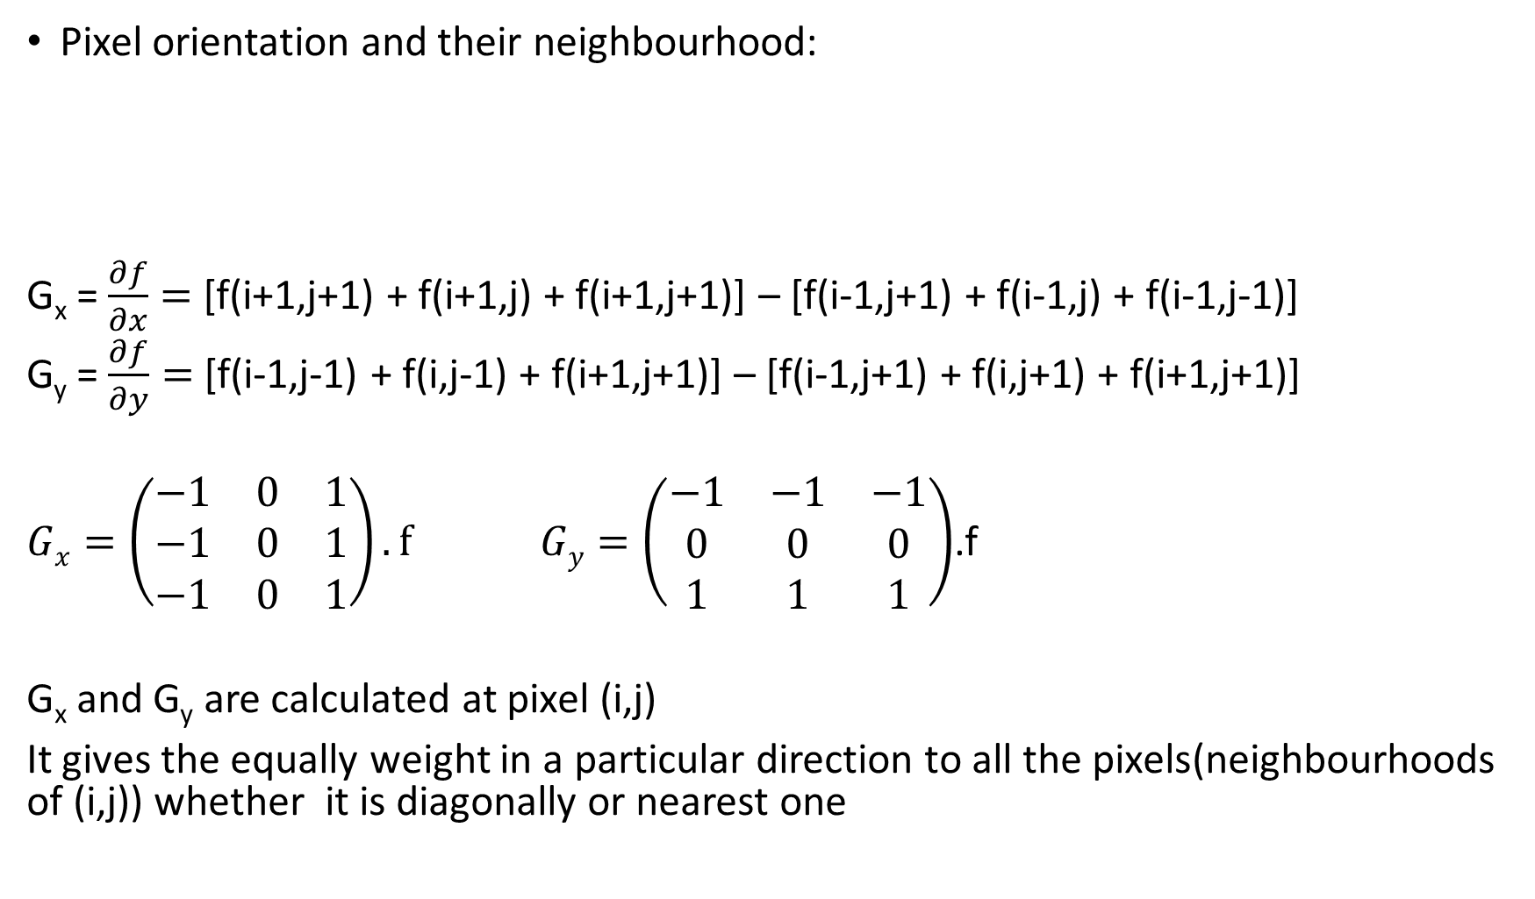
ii). Prewitt operator
Pixel orientation and their neighbourhood:
G_{x} = $\frac{∂f}{∂x}=$ [f(i+1,j+1) + f(i+1,j) + f(i+1,j+1)] – [f(i-1,j+1) + f(i-1,j) + f(i-1,j-1)]
G_{y} = $\frac{∂f}{∂y}=$ [f(i-1,j-1) + f(i,j-1) + f(i+1,j+1)] – [f(i-1,j+1) + f(i,j+1) + f(i+1,j+1)]
$Gx=\left(\begin{matrix}−1 & 0 & 1 \\ −1 & 0 & 1 \\ −1 & 0 & 1\end{matrix}\right).f$ $Gy=\left(\begin{matrix}−1 & −1 & −1 \\ 0 & 0 & 0 \\ 1 & 1 & 1\end{matrix}\right)$.f
G_{x} and G_{y} are calculated at pixel (i,j)
It gives the equally weight in a particular direction to all the pixels(neighbourhoods of (i,j)) whether it is diagonally or nearest one
f(i-1,j+1) | f(i,j+1) | f(i+1,j+1)
f(i-1,j) | f(i,j) | f(i+1,j)
f(i-1,j-1) | f(i,j-1) | f(i+1,j+1)
Pixel (i,j)

Slide 11
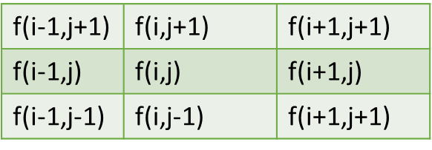
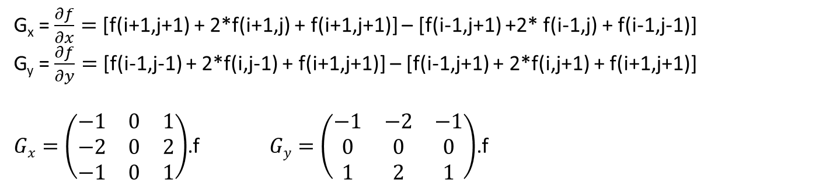
iii).Sobel Operator:-
It is similar to the Prewitt except it gives double weights to those pixels which are more nearest to the pixel of interest.
G_{x} and G_{y} are calculated at pixel (i,j)
G_{x} = $\frac{∂f}{∂x}=$ [f(i+1,j+1) + 2*f(i+1,j) + f(i+1,j+1)] – [f(i-1,j+1) +2* f(i-1,j) + f(i-1,j-1)]
G_{y} = $\frac{∂f}{∂y}=$ [f(i-1,j-1) + 2*f(i,j-1) + f(i+1,j+1)] – [f(i-1,j+1) + 2*f(i,j+1) + f(i+1,j+1)]
$Gx=\left(\begin{matrix}−1 & 0 & 1 \\ −2 & 0 & 2 \\ −1 & 0 & 1\end{matrix}\right)$.f $Gy=\left(\begin{matrix}−1 & −2 & −1 \\ 0 & 0 & 0 \\ 1 & 2 & 1\end{matrix}\right)$.f
More weights to these pixels
More weights to these pixels
G_{x} Pixel (i,j)
G_{y} Pixel (i,j)

Slide 12
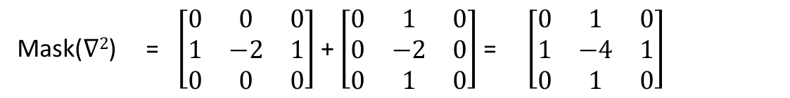
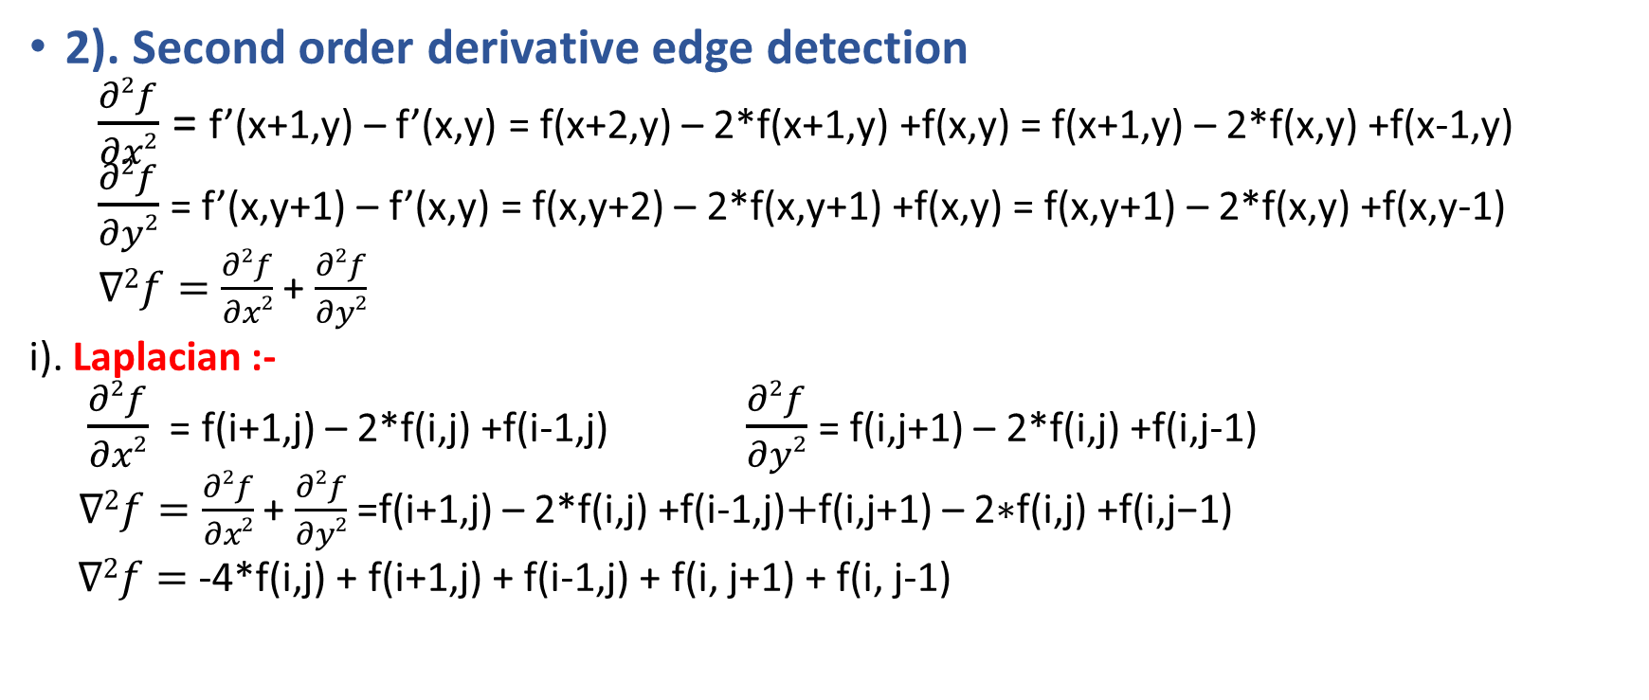
Edge Detection
2). Second order derivative edge detection
$\frac{∂2f}{∂x2}$ = f’(x+1,y) – f’(x,y) = f(x+2,y) – 2*f(x+1,y) +f(x,y) = f(x+1,y) – 2*f(x,y) +f(x-1,y)
$\frac{∂2f}{∂y2}$ = f’(x,y+1) – f’(x,y) = f(x,y+2) – 2*f(x,y+1) +f(x,y) = f(x,y+1) – 2*f(x,y) +f(x,y-1)
$∇2f=\frac{∂2f}{∂x2}$ + $\frac{∂2f}{∂y2}$
i). Laplacian :-
$\frac{∂2f}{∂x2}$ = f(i+1,j) – 2*f(i,j) +f(i-1,j) $\frac{∂2f}{∂y2}$ = f(i,j+1) – 2*f(i,j) +f(i,j-1)
$∇2f=\frac{∂2f}{∂x2}$ + $\frac{∂2f}{∂y2}$ =f(i+1,j) – 2*f(i,j) +f(i-1,j)$+\text{f}\text{(}\text{i}\text{,}\text{j}\text{+1) – 2∗}\text{f}\text{(}\text{i}\text{,}\text{j}\text{) +}\text{f}\text{(}\text{i}\text{,}\text{j}\text{−1)}$
$∇2f=$ -4*f(i,j) + f(i+1,j) + f(i-1,j) + f(i, j+1) + f(i, j-1)
Mask($∇2$) = $\left[\begin{matrix}0 & 0 & 0 \\ 1 & −2 & 1 \\ 0 & 0 & 0\end{matrix}\right]$+ $\left[\begin{matrix}0 & 1 & 0 \\ 0 & −2 & 0 \\ 0 & 1 & 0\end{matrix}\right]$= $\left[\begin{matrix}0 & 1 & 0 \\ 1 & −4 & 1 \\ 0 & 1 & 0\end{matrix}\right]$

Slide 13
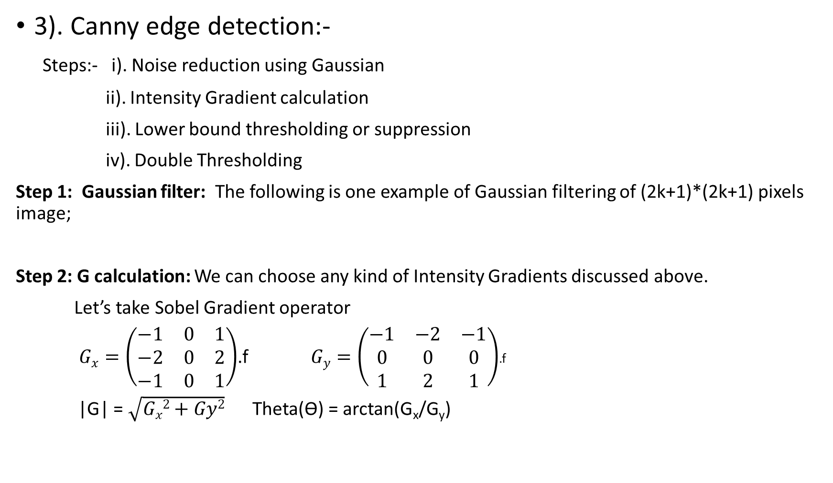
Edge Detection
3). Canny edge detection:-
Steps:- i). Noise reduction using Gaussian
ii). Intensity Gradient calculation
iii). Lower bound thresholding or suppression
iv). Double Thresholding
Step 1: Gaussian filter: The following is one example of Gaussian filtering of (2k+1)*(2k+1) pixels image;
Step 2: G calculation: We can choose any kind of Intensity Gradients discussed above.
Let’s take Sobel Gradient operator
$Gx=\left(\begin{matrix}−1 & 0 & 1 \\ −2 & 0 & 2 \\ −1 & 0 & 1\end{matrix}\right)$.f $Gy=\left(\begin{matrix}−1 & −2 & −1 \\ 0 & 0 & 0 \\ 1 & 2 & 1\end{matrix}\right)$.f
|G| = $\sqrt{Gx2+Gy2}$ Theta(ϴ) = arctan(G_{x}/G_{y})

Slide 14
Step 3: Lower bound thresholding:
Lower bound thresholding is applied to find the locations with the sharpest change of intensity value and used to get thin edge.
If ϴ = 0 and |G(i,j)|> |G(i + 1,j)| and |G(i, j)| >|G(i-1,j)| then the point (i,j) will be on the edge.
If ϴ = 90 and |G(i,j)|> |G(i ,j+1)| and |G(i, j)| >|G(i,j-1)| then the point (i,j) will be on the edge.
If ϴ = 135 and |G(i,j)|> |G(i -1,j+1)| and |G(i, j)| >|G(i+1,j-1)| then the point (i,j) will be on the edge.
If ϴ = 45 and |G(i,j)|> |G(i + 1,j-1)| and |G(i, j)| >|G(i-1,j+1)| then the point (i,j) will be on the edge.
Step 4: Double Thresholding : it is essential to filter out edge pixels with a weak gradient value and preserve edge pixels with a high gradient value.
If |G(i, j)| > G_{HT} then this pixel (i, j) will be considered as strong edge pixel.
If |G(i, j)|< G_{HT} And |G(i, j)| > G_{LT} then this pixel will be considered as a weak edge pixel.\
In all the others remaining cases we will not take those pixels in our edge and they will be suppressed.
here G_{HT} :- High Threshold value for pixel to detect the edge
G_{LT} :- Lower Threshold value for pixel to detect the edge.
|G(i, j)| :- the intensity gradient at pixel (i, j)

Slide 15
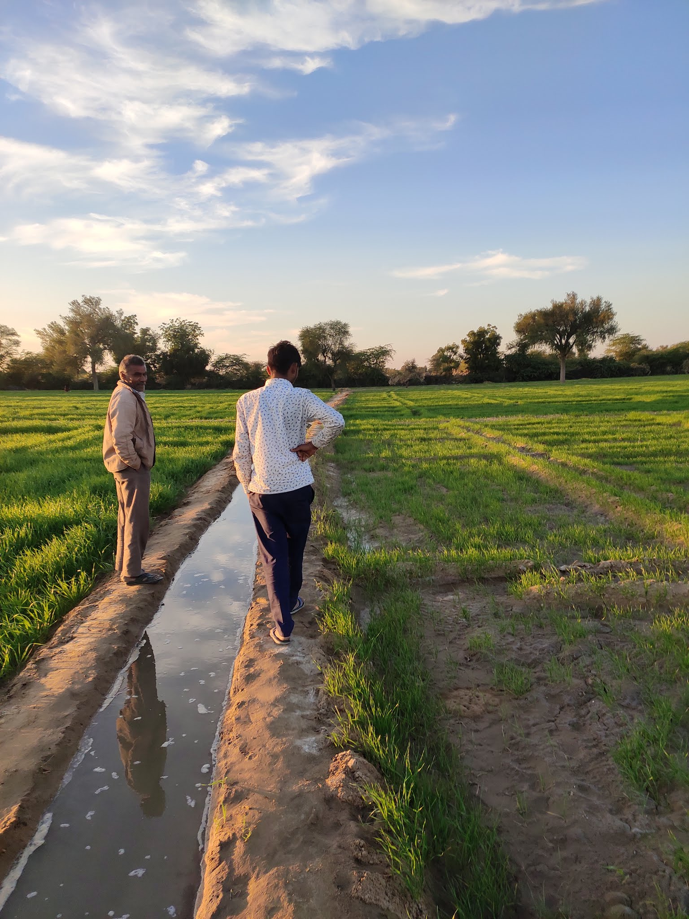
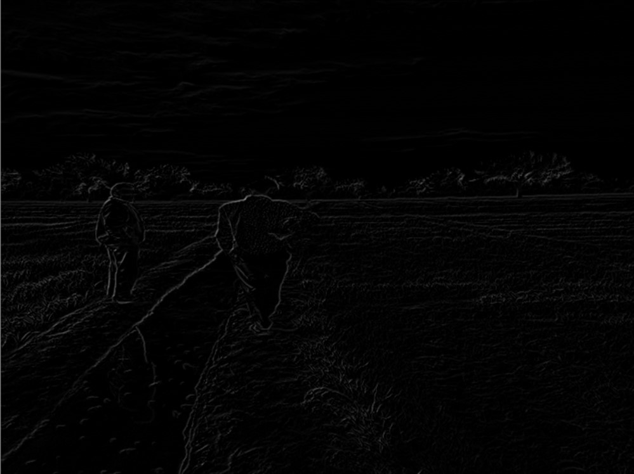
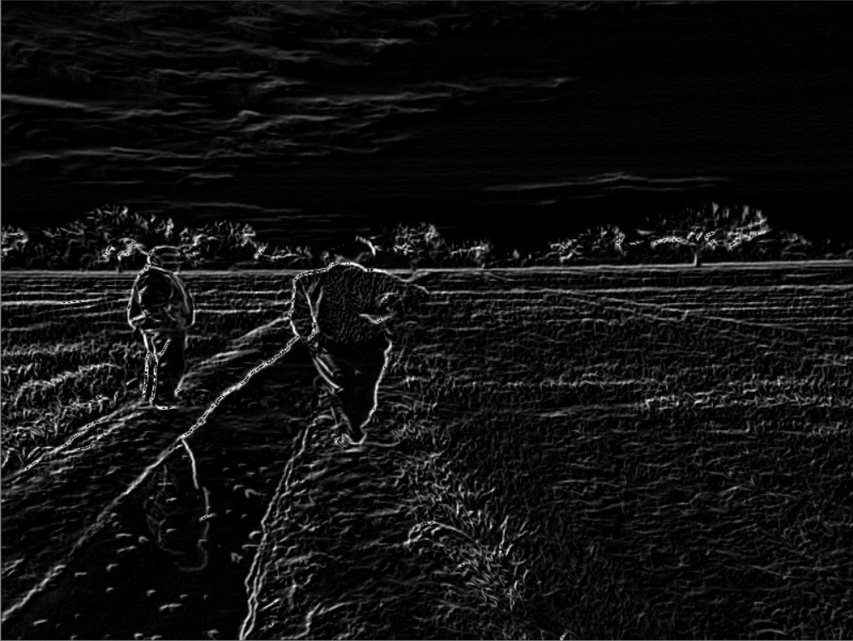
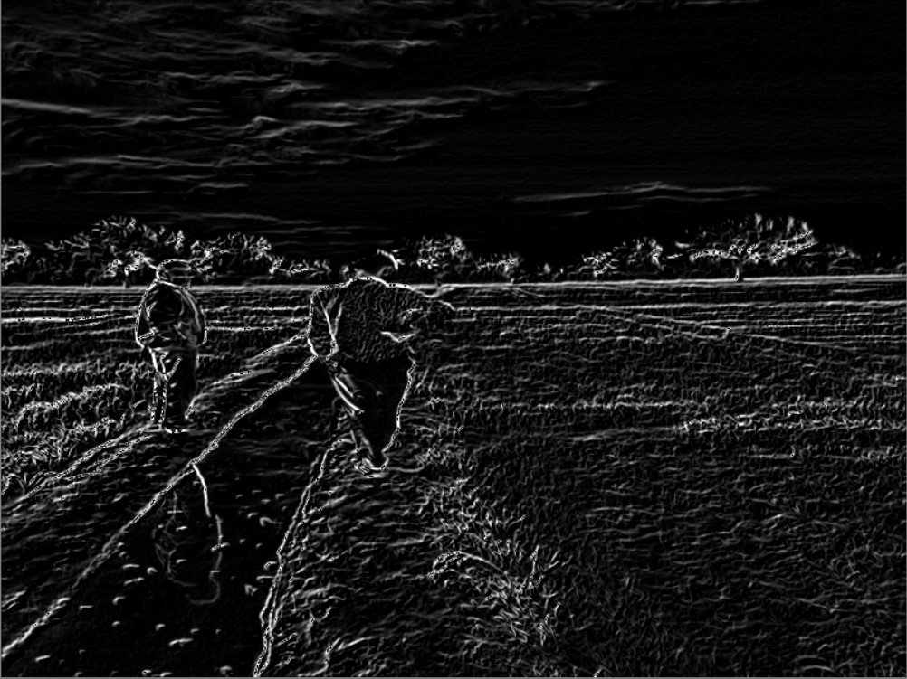
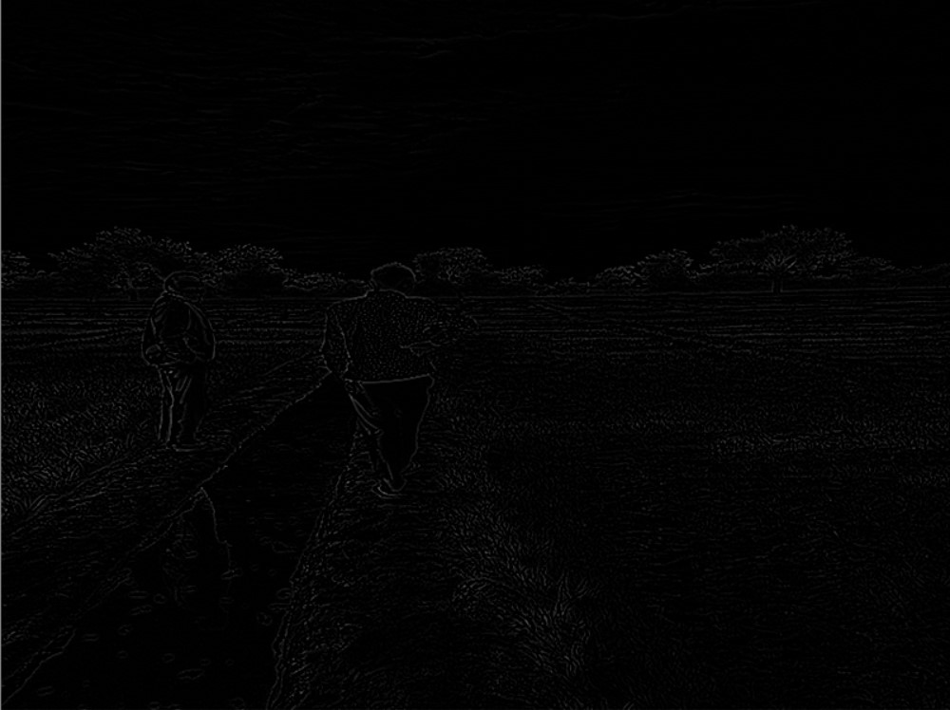
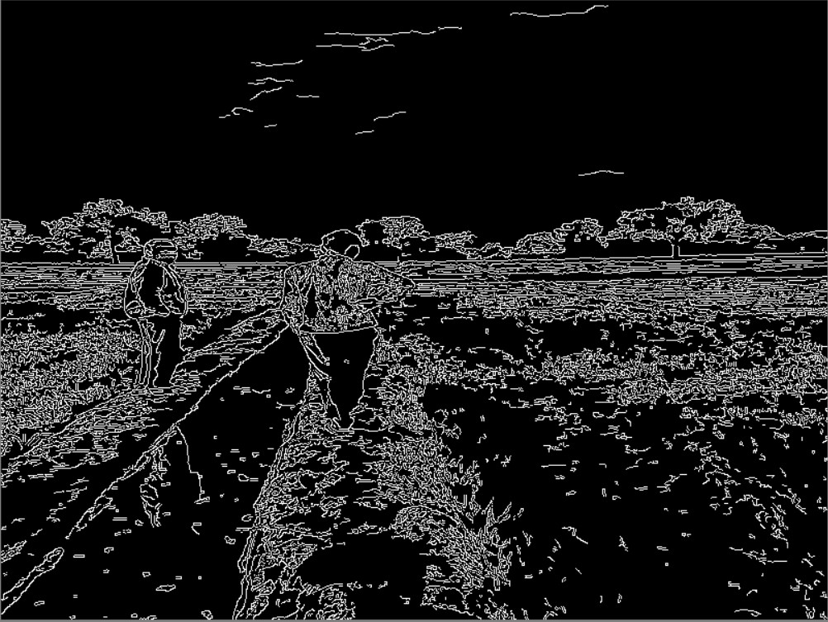
Original Image Roberts detection Prewitt detection
Sobel Detection Laplacian Detection Canny

Slide 16
3). Region based segmentation
It is carried out based on similarities in the image.
It can be carried out in different ways
1)Region Growing
2)Region Splitting
3)Region Merging
4) Split and Merge
Region Growing based segmentation is implemented here.In this,
Pixels are grouped into larger regions based on predefined conditions.
Approach is to pick a seed point and grow region from it.

Slide 17
Implementation
Convert the RGB image to grayscale image.
Taking a seed (starting pixel).
The nearest neighbours of a pixel (x,y) (starting is the seed pixel) are computed.
The neighbouring pixel is accepted in the same region as (x,y) if it satisfies the growing condition.
The growing condition here is that the intensity of a pixel greater than the average of intensities of its neighbouring pixels.
Once the new pixel is accepted,the neighbours of this pixel are examined.
The procedure goes on until no new pixel is accepted into the region.

Slide 18
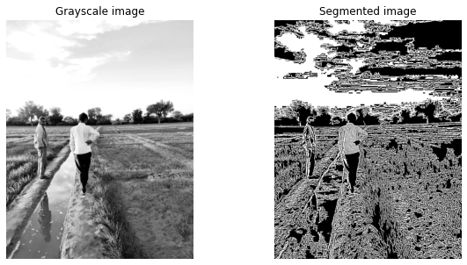
Results

Slide 19
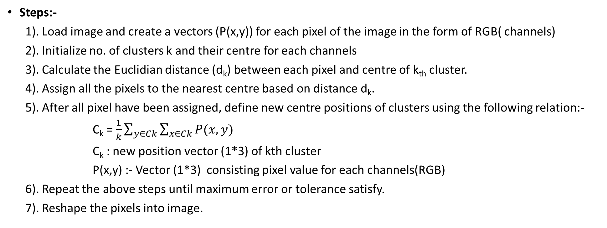
4). K-mean Clustering
Steps:-
1). Load image and create a vectors (P(x,y)) for each pixel of the image in the form of RGB( channels)
2). Initialize no. of clusters k and their centre for each channels
3). Calculate the Euclidian distance (d_{k}) between each pixel and centre of k_{th} cluster.
4). Assign all the pixels to the nearest centre based on distance d_{k}.
5). After all pixel have been assigned, define new centre positions of clusters using the following relation:-
C_{k} = $\frac{1}{k}\sum_{y∈Ck}{\sum_{x∈Ck}{P(x,y)}}$
C_{k} : new position vector (1*3) of kth cluster
P(x,y) :- Vector (1*3) consisting pixel value for each channels(RGB)
6). Repeat the above steps until maximum error or tolerance satisfy.
7). Reshape the pixels into image.

Slide 20
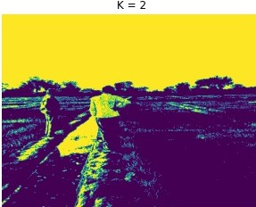
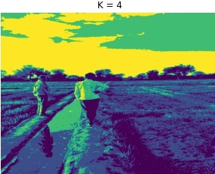
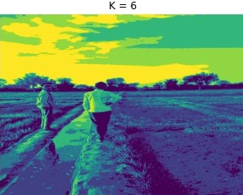
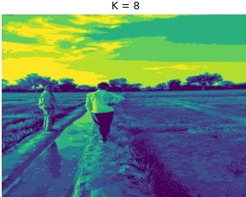

Slide 21
5). Watershed based Segmentation
It is defined on a Gray scale image.
It treats the image like a topographic map with the intensity of each pixel representing its height.
The basic idea is to divide the heights (in the topographic map along with their corresponding regions in XY plane) into appropriate regions/segments.
It is primarily used for segmentation of like objects.
There are various watershed algorithms, we use watershed flooding algorithm.

Slide 22
Flooding Algorithm
The markers are user defined .If undefined, local minimas are taken as markers.
The algorithm floods water from the markers and creates barriers where floods of different water sources meet.
Implementation
1.Convert the RGB image to gray scale image and remove the noise.
2.Do image thresholding
3.Compute distance matrix with respect to black pixels
4.Compute the local peaks of distance matrix and use them as markers
5.Do watershed flooding by using above markers and using -1*distance matrix
Local peaks of distance matrix are local minimas of -1*distance matrix

Slide 23
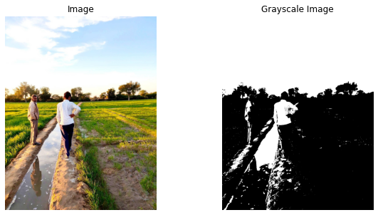
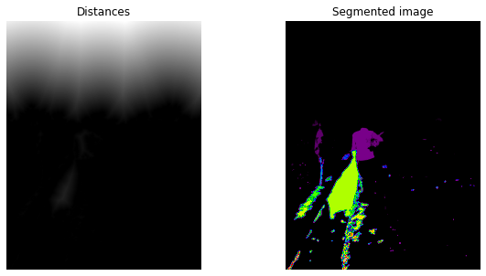
Results

Slide 24
Conclusion
Method | Description | Uses
Thresholding | Based on histogram peak detection and finding out the threshold values | Best for binary segmentation
Edge based segmentation | Jump detection from one region to another region | To detect the boundary of object in image
Region based segmentation | Similarity in pixel’s property | To detect different regions in image
K – means segmentation | Homogenous region clustering | Region detection
Watershed based segmentation | Topological interpretation | To detect continuous boundary between two region

Slide 25
Work division
Name | Roll no | Work
Gudla Raghunandan Reddy | 190010027 | 1.Watershed based Segmentation 2.Region based Segmentation
Pukh Raj | 190110068 | Thresholding Edge-based segmentation (First order derivative methods)
Satyajeet Shahaji Machale | 190110085 | K-means clustering Edge-based segmentation (Laplacian and Canny edge detection)

